Slide 1

Religion &
Worldviews
The 2022 Agreed Syllabus for Hull and East Riding:
https://www.hereforschools.co.uk/page/19378
Notes:
Statutory for all 5-19
Note religion (singular) and worldviews (plural)

Slide 2
Previous syllabi
- 6 major world faiths
Buddhism
Christianity
Hinduism (Sanatana Dharma)
Judaism
Islam
Sikhism (Sikhi)
Notes:
Debates over last 5 years
-isms have come out - decolonisation agenda

Slide 3

2022 Religion & worldviews
Explores different ways of being Christian, Muslim, Sanatani, Sikhi…
Now includes religious & non-religious ‘worldviews’
Promotes formation of a personal worldview
Notes:
Still called RE in legislation, but syllabi are moving on as they are reviewed.
Significance of personal worldview for both teachers and pupils.
No one is excluded – whilst still have right of withdrawal, it’s unnecessary in an inclusive curriculum covering all worldviews.

Slide 4
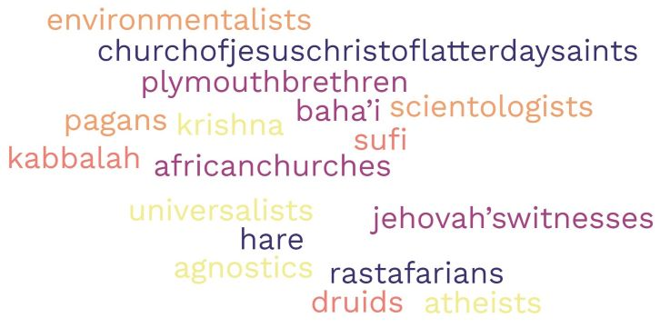
2022 syllabus
- religion & worldviews
Notes:
There are set learning objectives but schools have free choice with regard to local context.
Schools have surveyed makeup of local community and had some surprises! (2021 Census)

Slide 5



Slide 6

Nobody Stands Nowhere
Nobody Stands Nowhere - YouTube

Slide 7
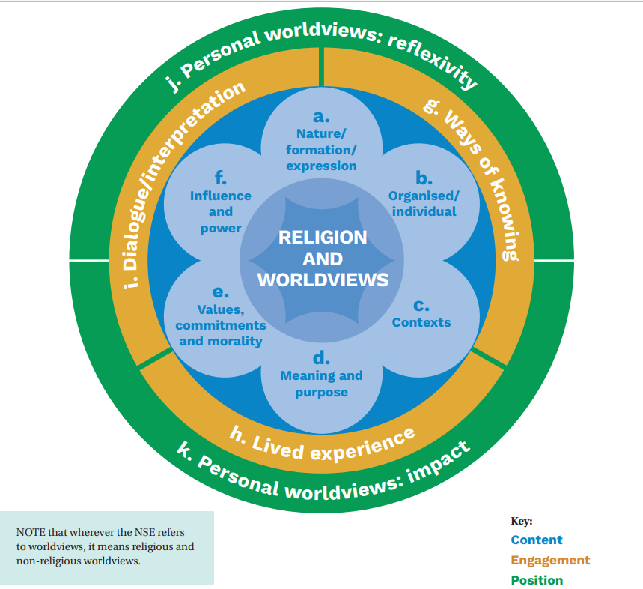
Notes:
Importance of children finding out about lived experience through dialogue and reflecting on the impact it has on the individual

Slide 8
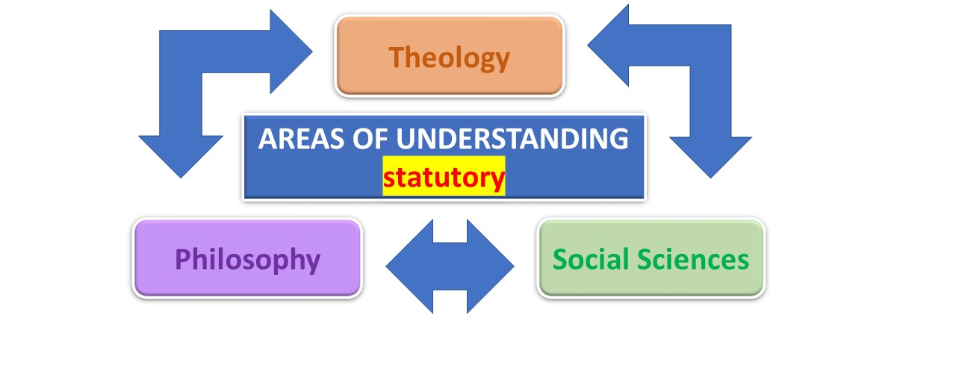
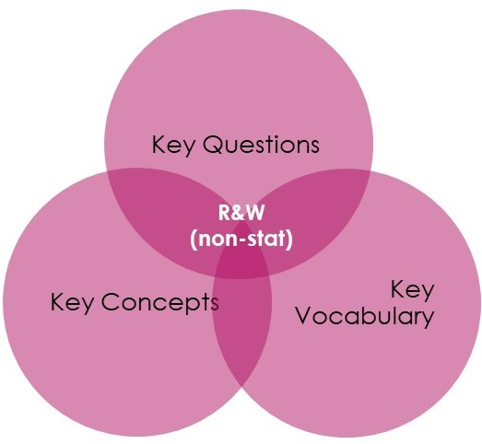
The 2022 syllabus in a nutshell
Ask questions
Investigate & dig deeper
Interpret & analyse
Evaluate & review
Reflect & respond
ENQUIRY CYCLE
Units of learning
Notes:
Established ‘Enquiry Cycle’ - importance of asking questions, investigating as philosophers, theologians or social scientists
Ways of knowing = areas of understanding = balance
Non-statutory units of learning exemplifying activities to address Key Qs, Vocab, Concepts of chosen worldviews
Teachers find ‘Worldviews’ a stimulating approach & relevant to everybody

Slide 9
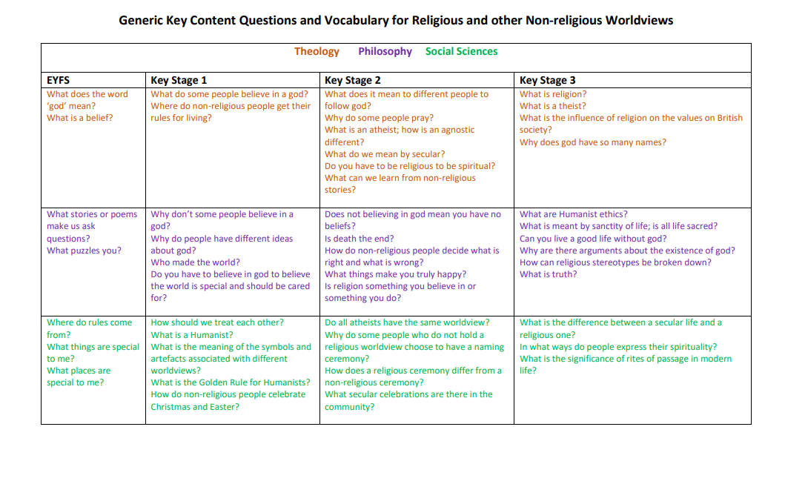
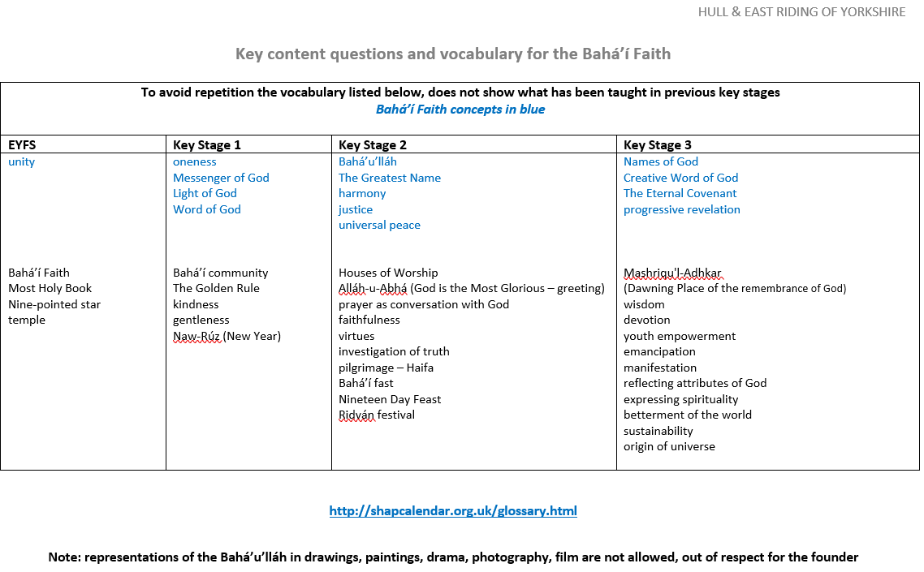
Notes:
The syllabus provides for a more open style of questioning, organised around the 3 ‘ways of knowing’
Concepts are the ‘Golden Threads’

Slide 10
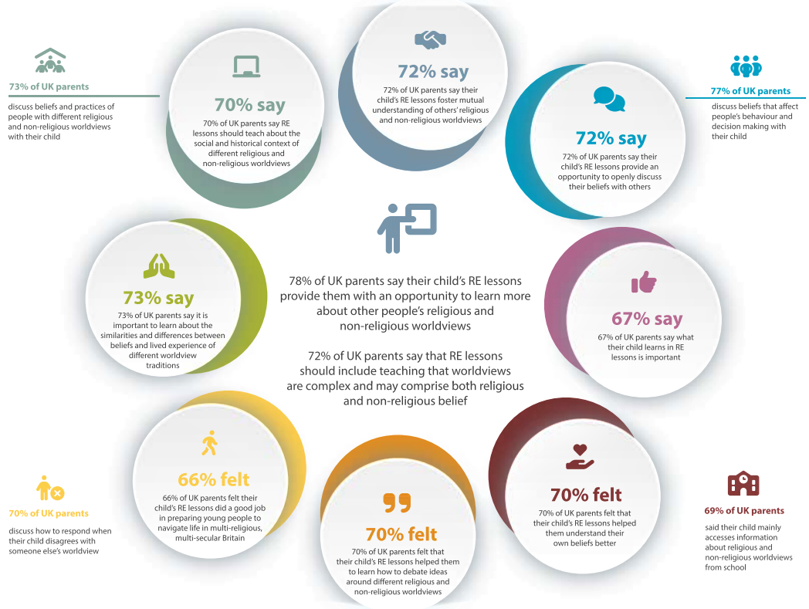
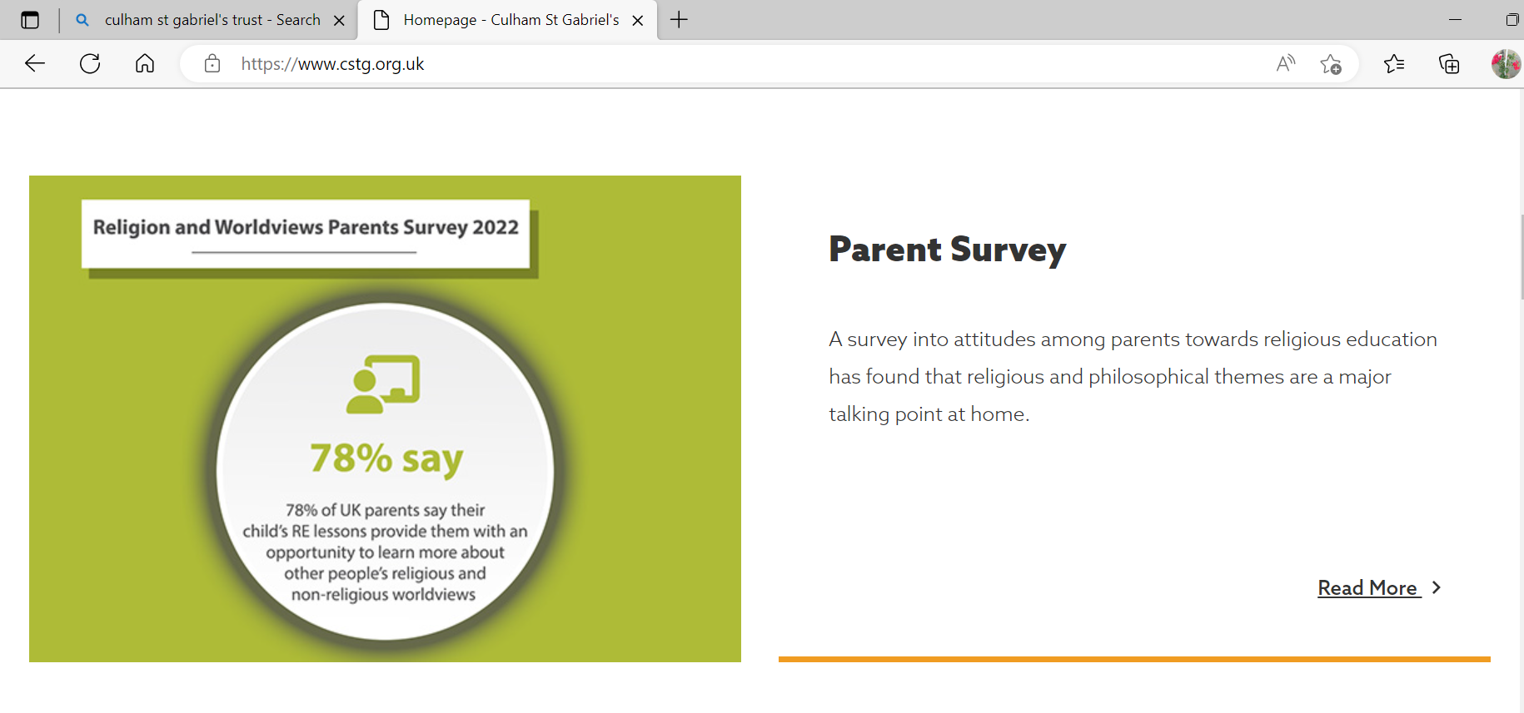
Culham St Gabriel’s Trust

Slide 11
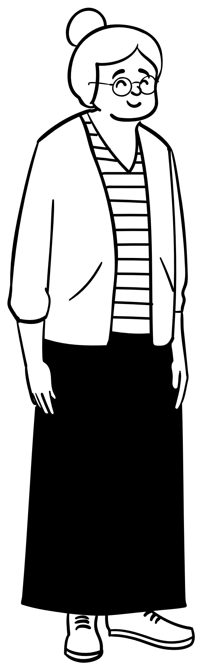
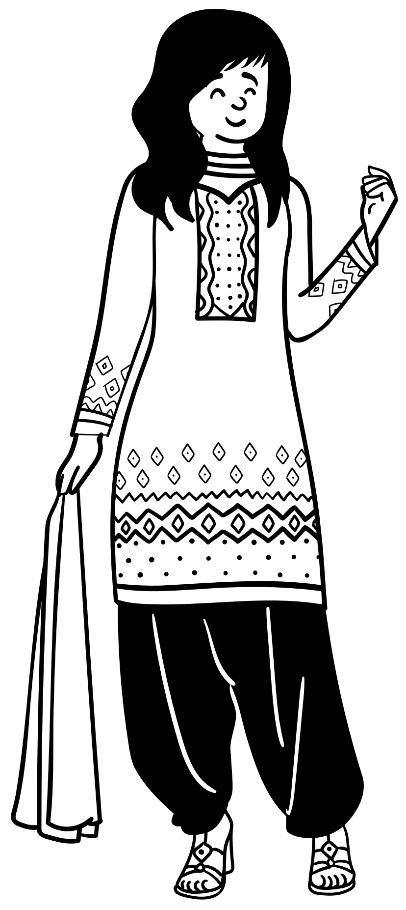


Personal Worldview
WHAT'S YOUR WORLDVIEW?- YouTube

Slide 12
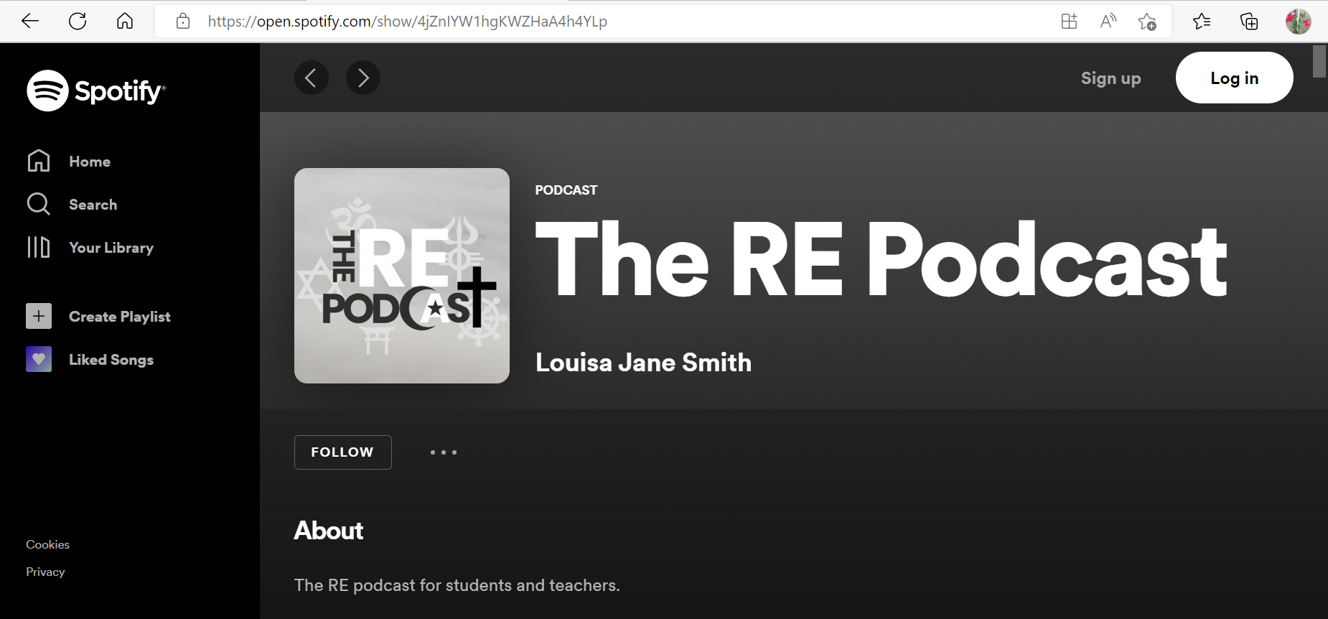
The one about Worldviews
Notes:
Play 6.57’ - 9.08’

Slide 13




Thank you
Marilyn Cowling
marilynccowling@gmail.com
Sue Holmes
sueholmes@email.com
https://reinhull.wordpress.com/

Slide 14
Discussion questions
How can you support schools to offer an inclusive RE curriculum?
Can you articulate your personal worldview and talk about how it has developed?
Does your community have resources to offer schools to help children learn about different worldviews?
What can we do to support you to help schools engage with religion and worldviews?
Notes:
Each SACRE in the country is responsible for publishing and then monitoring its AS, and SACRE members are active in supporting it.
Ideally, main belief groups are represented on the local SACRE, and other worldviews are drawn into schools to support the worldviews conversation.
SACRE members to contribute to answering Qs.

